Slide 1

Build AI that really works
How Promptbook helps the
transition from typewriters to
personal computers
Pavol Hejný & Jiří Jahn
2025-02-18, Deloitte
1

Slide 2
The Book
We make the Book, next-generation language for AI
You no longer need ML Department to create your own personal AI apps
#
Email to customer
- PERSONA George, experienced AI consultant
- KNOWLEDGE https://deloitte.com/
- KNOWLEDGE https://ptbk.io/
## Write the email
> Write an email to {customerName} about opportunities in
> AI consulting and new trends in the industry.
> Include a link to the Deloitte website and also mention
> the Promtbook platform.
-> {email}
2

Slide 3
The Benefits for you
Faster, cost-effective solution
Highly scalable and maintainable (due to separation of concerns)
Easy debugging (due to sophisticated logging and error monitoring capabilities)
All team members develop against unambiguous specification
Enables non-technical consultants to create LLM-powered applications
3

Slide 4
Routine Task Automation
Automation of document generation, reports, and data entry
Streamlining approval workflows and notifications
4

Slide 5
Knowledge & Insights
Creating dynamic knowledge bases for internal teams and clients
Automating industry insights collection and distribution
Implementing AI-based decision support tools for clients
Automating data analysis for trend identification and forecasting
5

Slide 6
Client Solutions
Rapid MVP creation to validate business ideas
Designing AI-powered solutions tailored to specific client requirements
Building chatbots, virtual assistants, and other customer interaction tools
Personalizing customer journeys in marketing and support
6

Slide 7
Internal Operations
Automating internal project management and resource allocation workflows
Streamlining RFP creation and responses
7

Slide 8
Risk & Compliance
Automated compliance monitoring and reporting
Real-time regulatory update analysis and implementation
AI-driven risk analysis for client portfolios
Automated due diligence processes
AI-assisted audit planning and execution
Automated tax calculation and optimization
ESG compliance monitoring and reporting
Built-in encryption out of the box
8

Slide 9
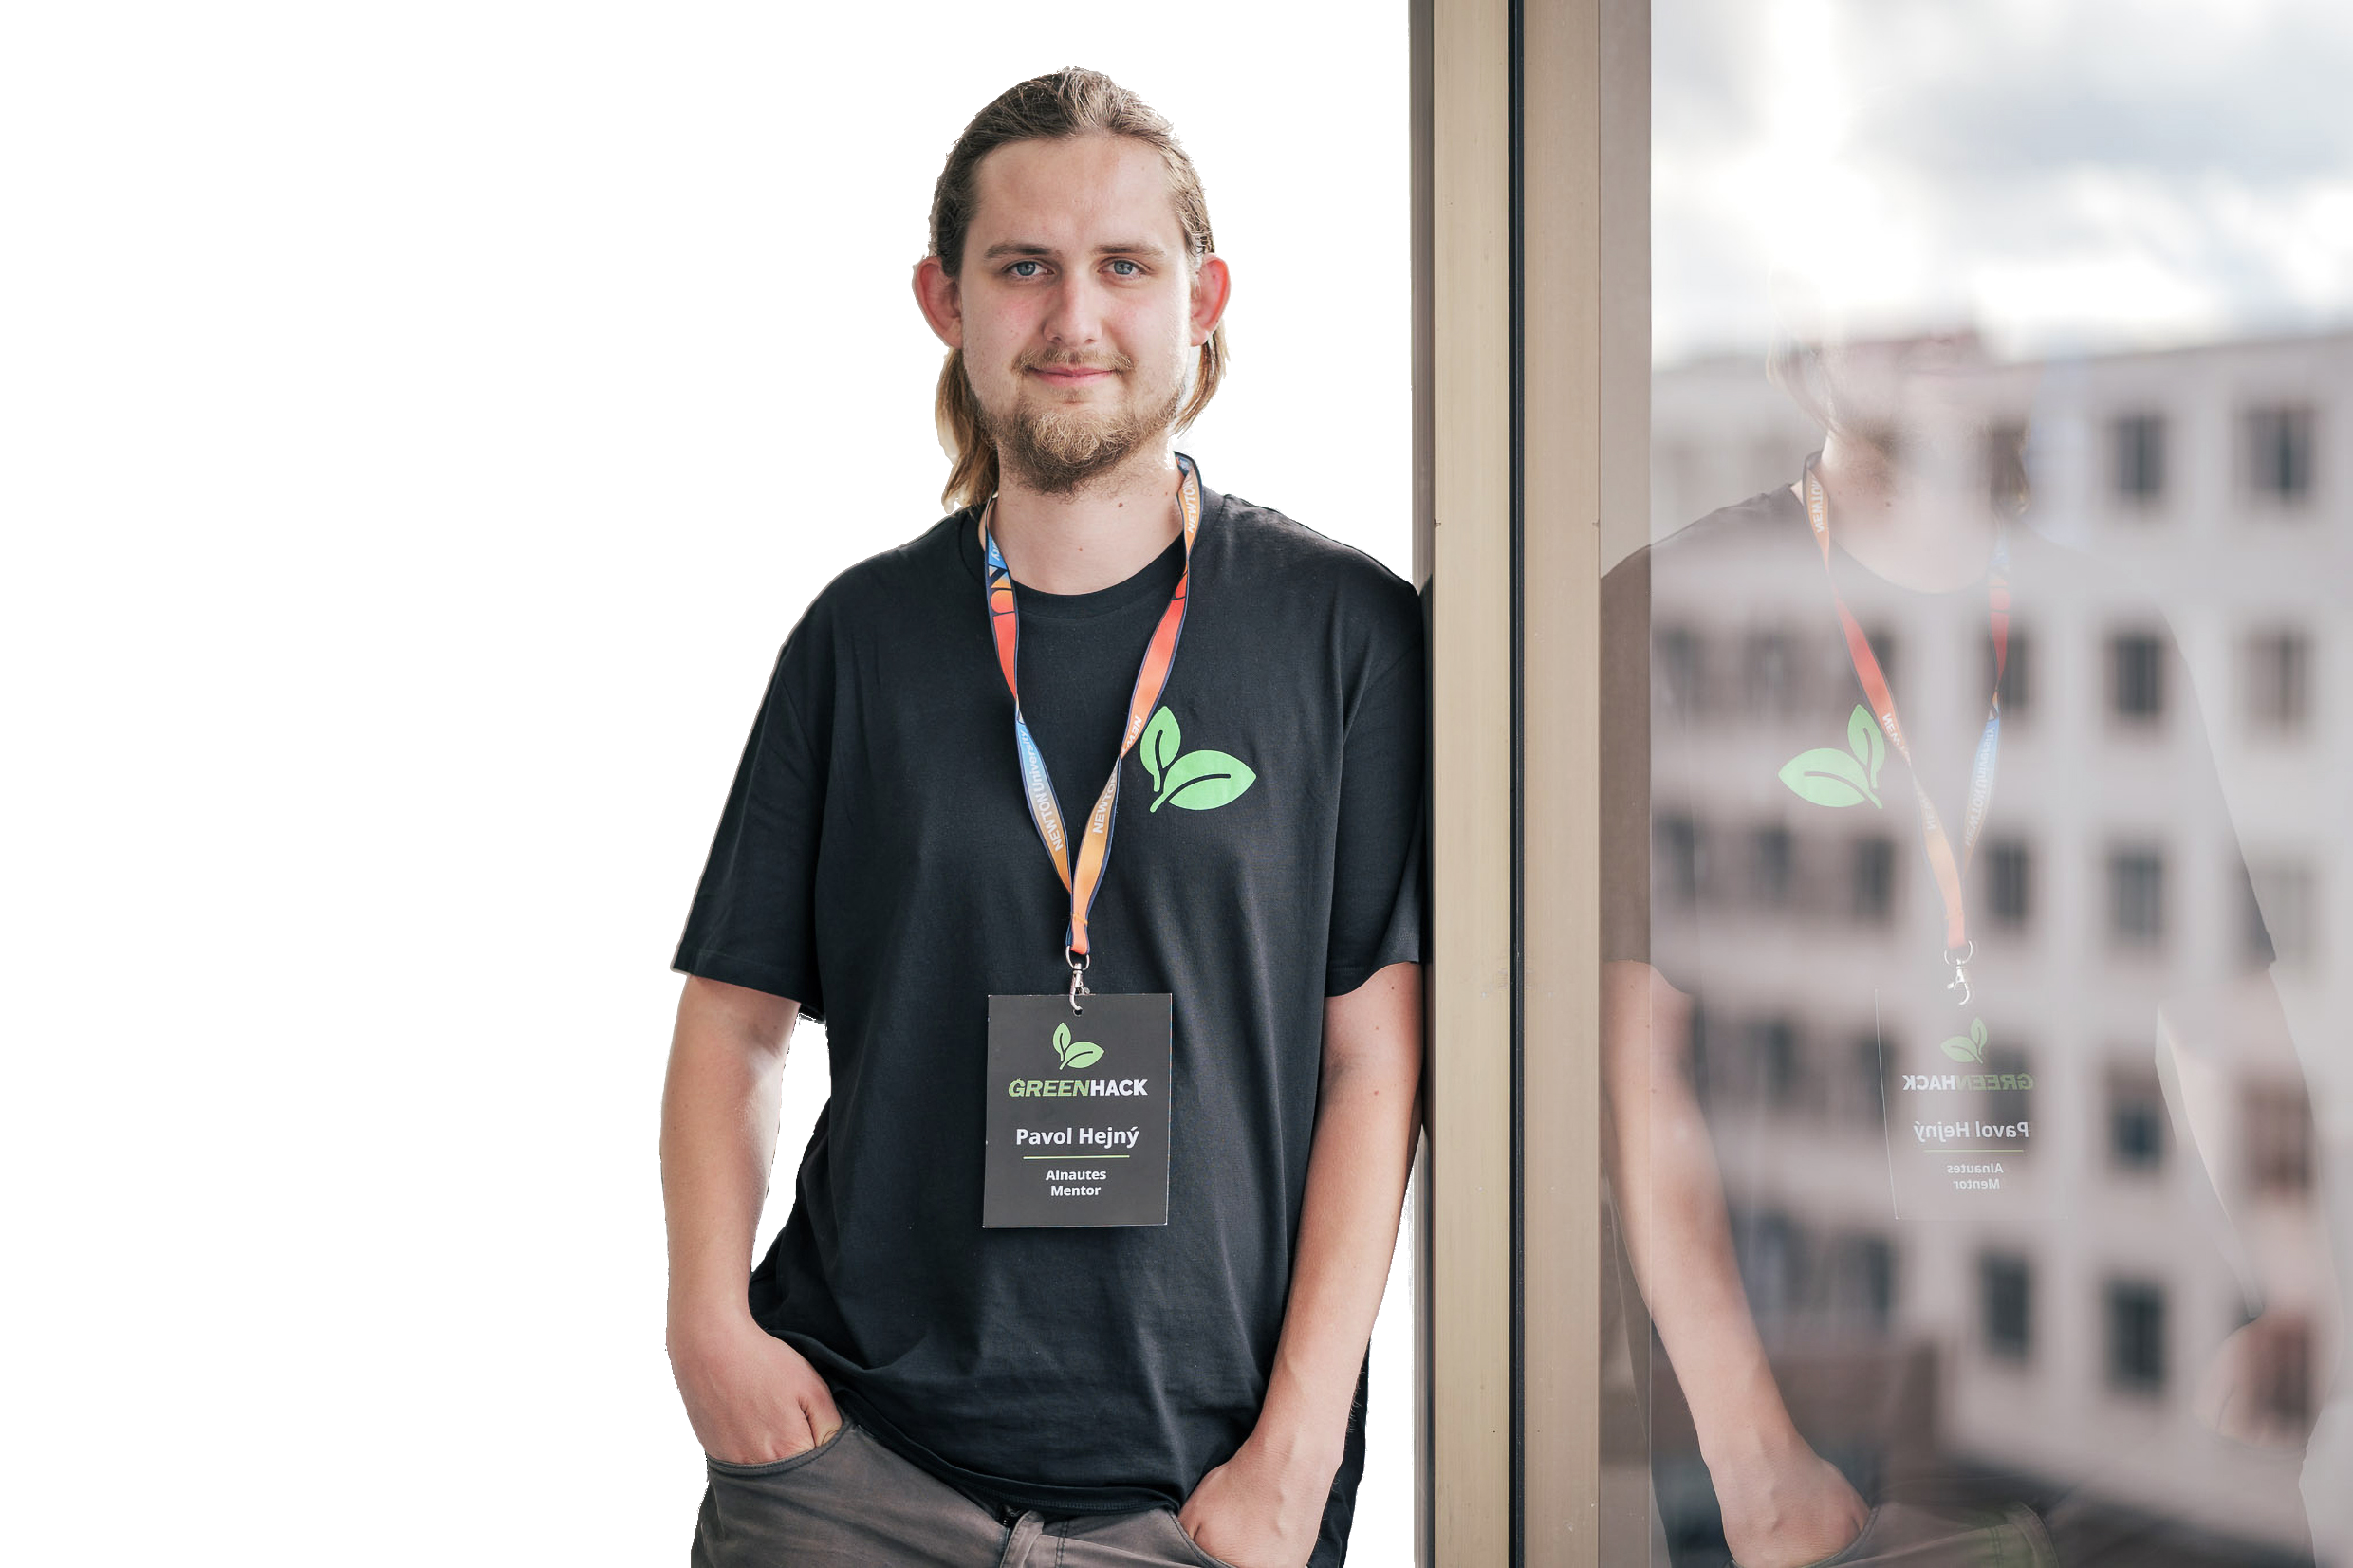

Our Team
Pavol Hejný
Jiří Jahn
CTO & Co-founder
CEO & Co-founder
Top open-source contributor in CZE
Ph.D. in Mathematics, former researcher at
Developer with 15+ years of experience
IT4I National Supercomputing Centre
Significant technical expertise mixed with
strong soft skills
9

Slide 10
Our Unique Insights
1. We are not NO CODE platform
For devs these platforms lack control
For non/devs they are still programming with a crutch
2. Anticipating futute trends
Mixing prompts with code will lead to technical debt
We are separating things that should be separated
3. Models are commodity, we make the best assistants
Models are like Intel processors in Apple
You can replace Intel with Arm, but you cannot replace Apple
10

Slide 11
Let's Connect
Jiří Jahn
jiri@ptbk.io
+420 777 090 067
Pavol Hejný
pavol@ptbk.io
+420 777 759 767
11

